Slide 1
LibAnswers Suite

Slide 2
LibAnswers Suite
RefAnalytics
Record reference statistics
In person
LibChat
Monitor chat dashboard
Interact with patrons & answer questions
Virtual (chat, email, etc.)

Slide 3
LibAnswers
RefAnalytics
Virtual Reference
In-Person Reference

Slide 4
LibAnalytics – What is it?
Online tool for tracking reference statistics and interactions with patrons (in person, online, etc.)
Enables gathering of reference statistics at all CCAC Libraries
This will be replacing paper statistics forms at the reference desk
Let’s see the interface…

Slide 5
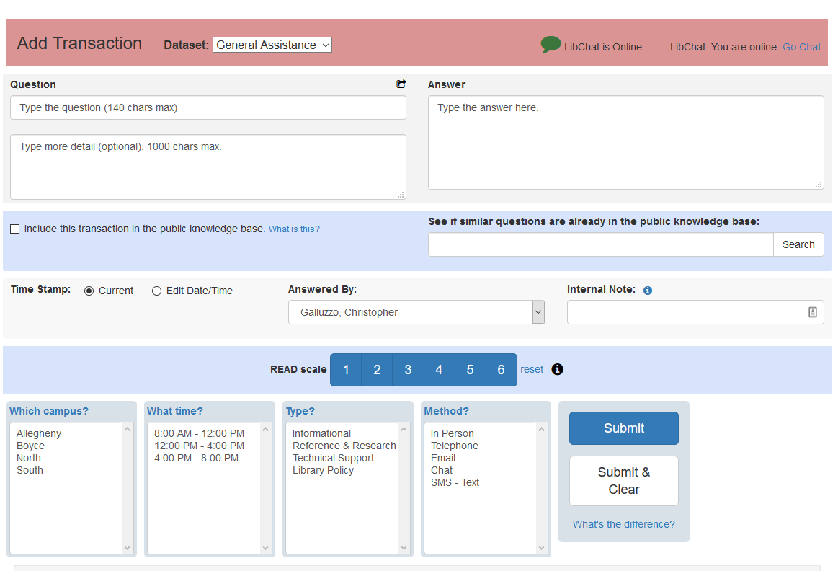

Slide 6
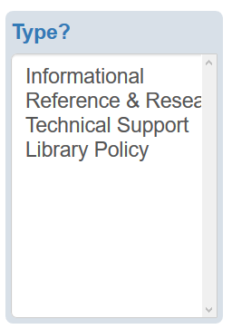
Informational
Directional
NetID-related
Reference & Reference
Library Policy
Technical Support

Slide 7
Canned messages
May be helpful for frequently asked questions
Two types
System messages – available to everyone
Individual – you can make your own!
Available for use in the LibChat dashboard

Slide 8
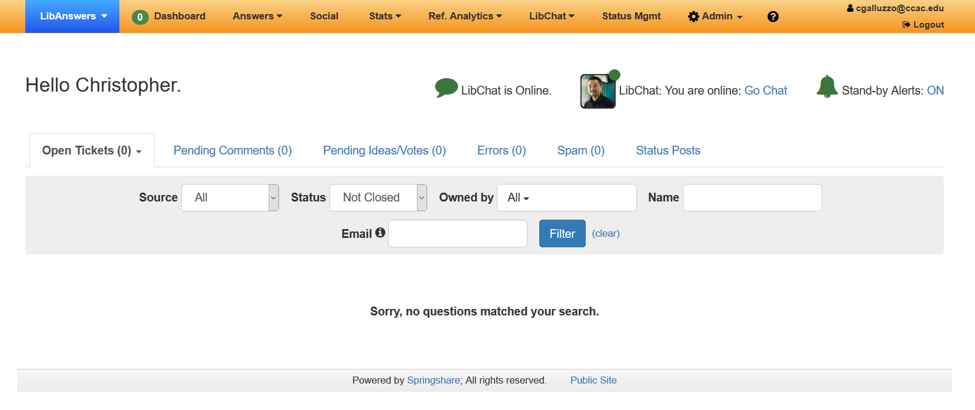
Answering Questions – Main Dashboard

